Slide 1
EENG 385 Deboo Integrator
Notes:
Usually the <title of the lab> is what will be called the “System” through the rest of this document

Slide 2
Lab Objectives
Introduce the operation of the Deboo Integrator and its interactions with the 555 Timer and the Schmitt Trigger Relaxation Oscillator to create a staircase voltage waveform.

Slide 3
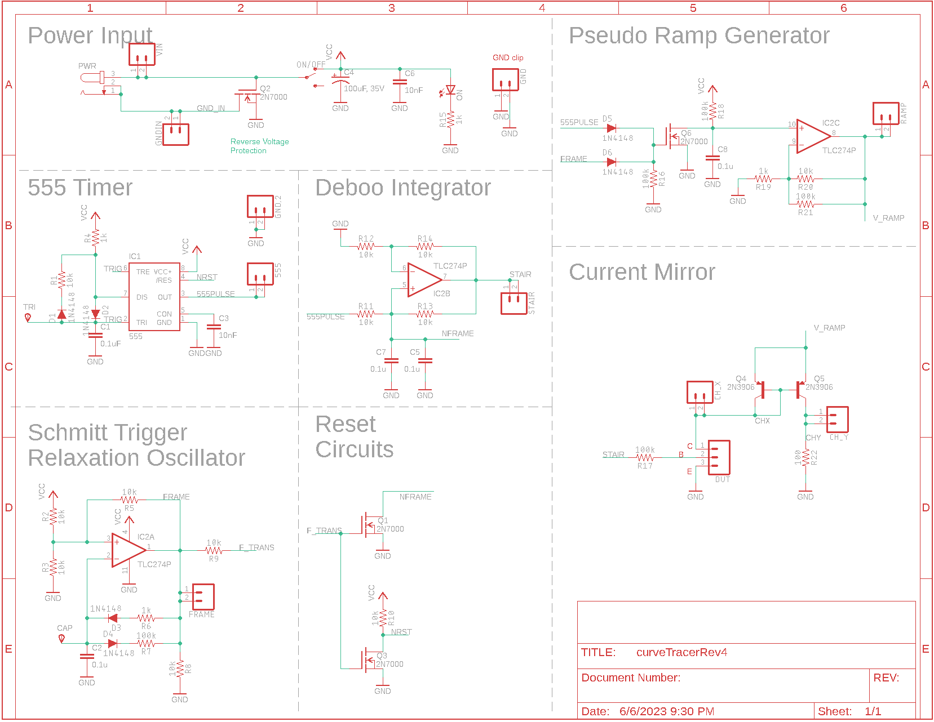
Theory
Vout = k * ⌠ vin(t) dt
Interactions
555 Timer to provide voltage
Schmitt Trigger resets integrator

Slide 4
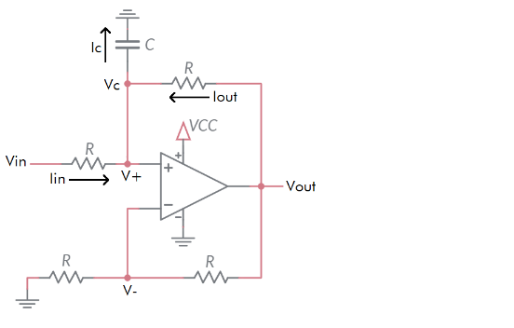

Theory
$$v_{out}\left(T\right)=k∗\int_{0}^{T}{v_{in}\left(t\right)ⅆt}$$
k will depend on R and C

Slide 5
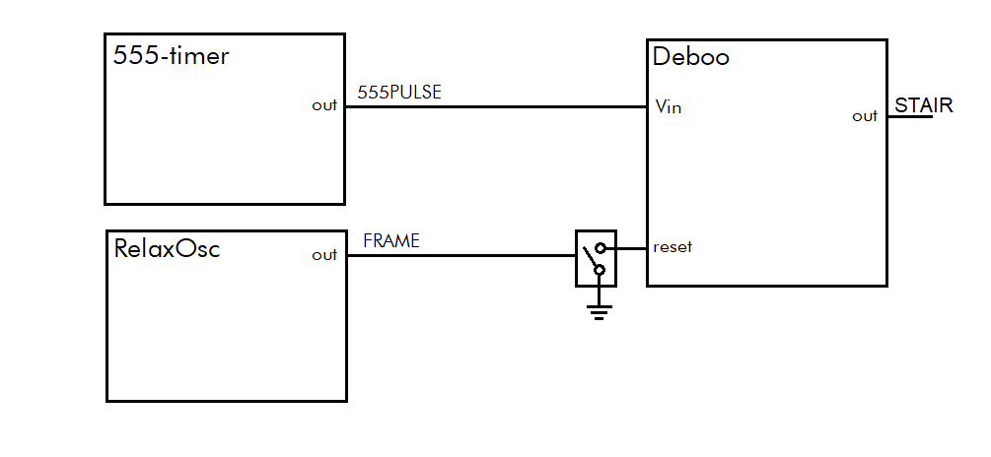
Theory
Deboo Integrator
Integrates 555PULSE creating a staircase waveform
Output voltage reset on high pulse from Schmitt Trig Relax Osc

Slide 6
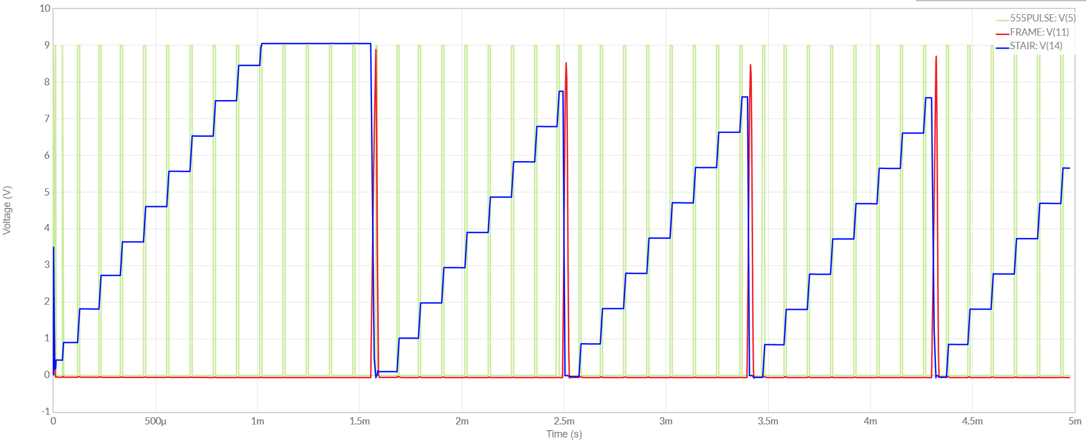
Simulate
Start with Lab 1 or Lab 2 circuit, add components
Set initial conditions on capacitor

Slide 7
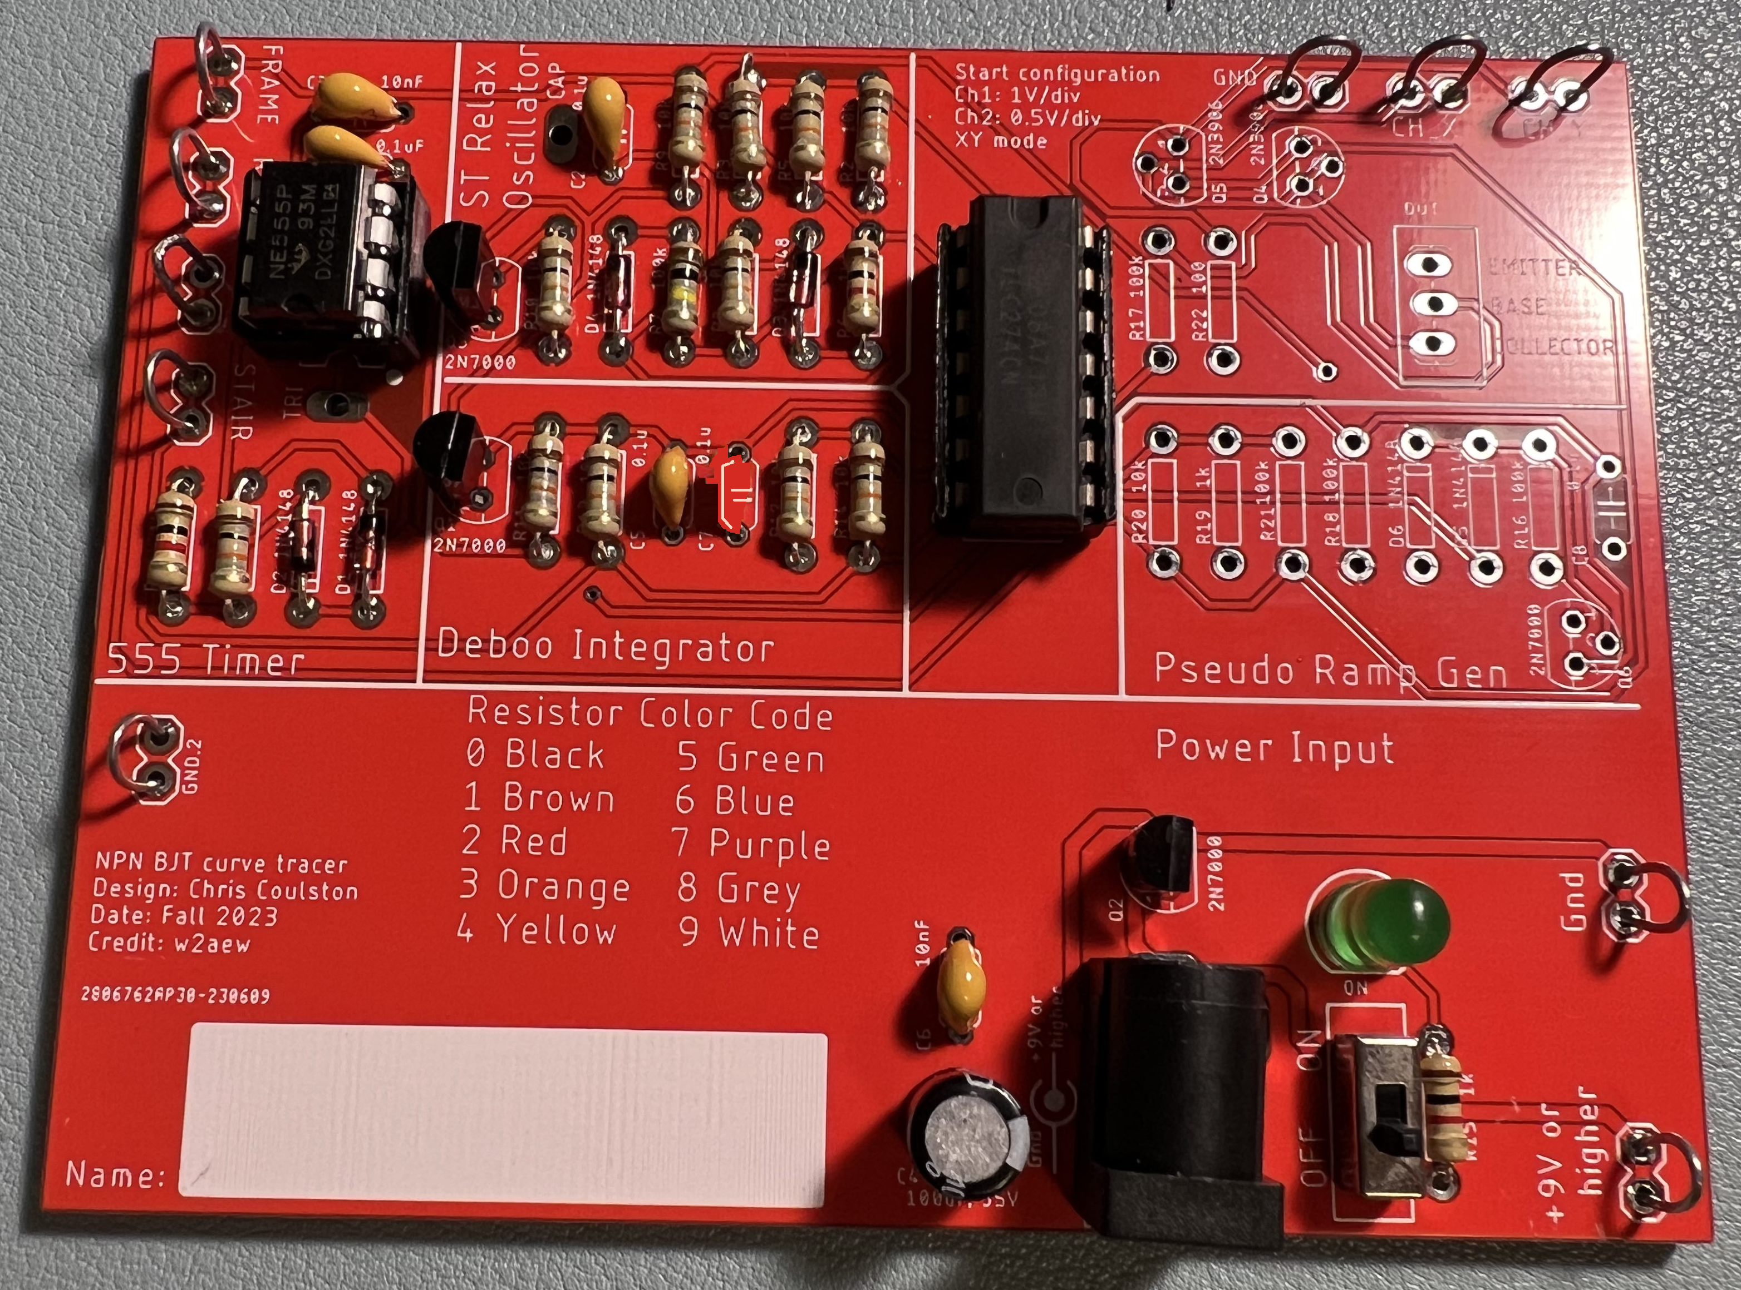
Assemble
MOSFET is polarized
Leave capacitor C7 empty
Notes:
Replace <System> with the name of the

Slide 8
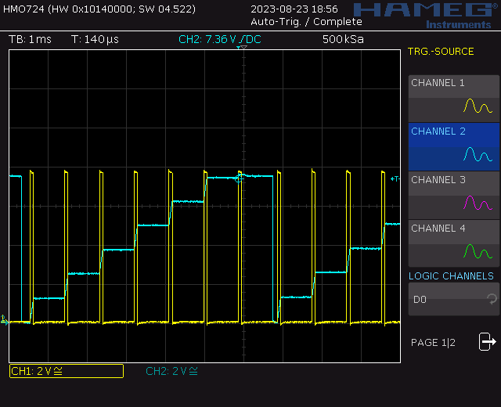
Test
Probe 555TIMER (blue) and STAIR (yellow)
Notes:
Replace <System> with the name of the

Slide 9
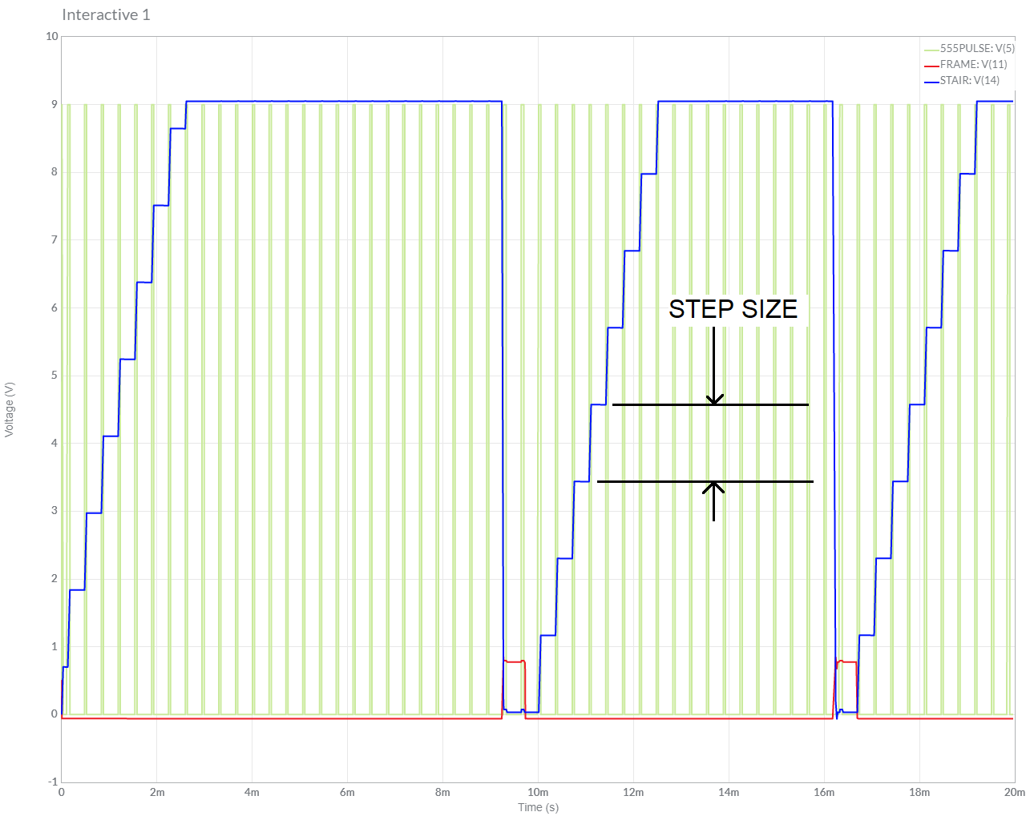
Turn In
Summary of analysis, simulation and assemble
Table 2 Step Size
Answer listed questions
Save solutions as PDF
Due before start of class next week
Every student builds their own board
Everyone brings their board to class

